Slide 1



Data Centre Frontier
Helping create the Asia-Pacific data centre capital in Australia
Notes:
Australia Seeks to become the Data centre capital of Asia-Pacific but to do this it will need to build these new data centres, and to do that the best location for these data centres need to be determined

Slide 2
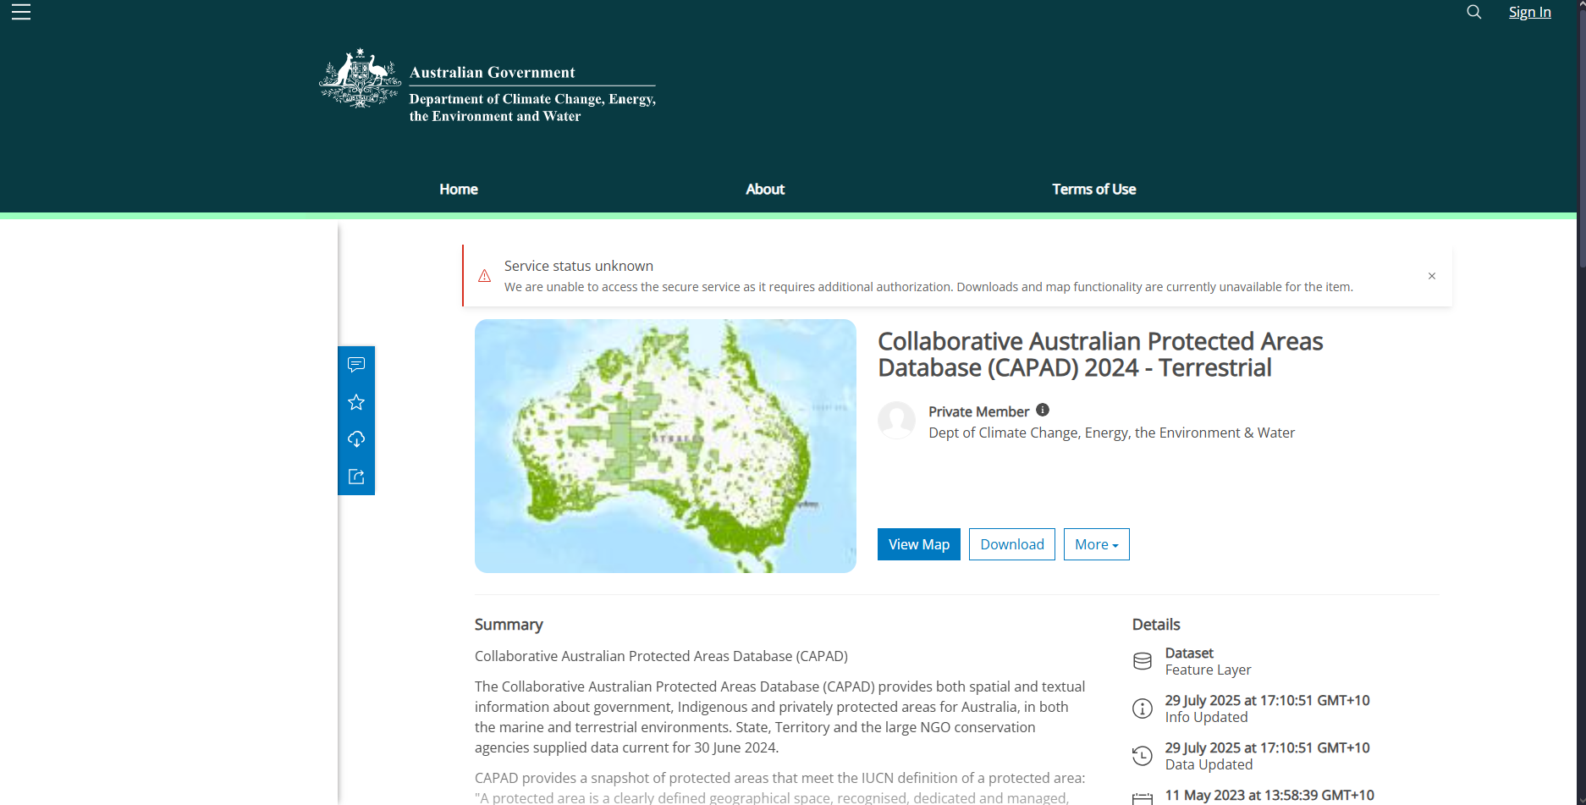
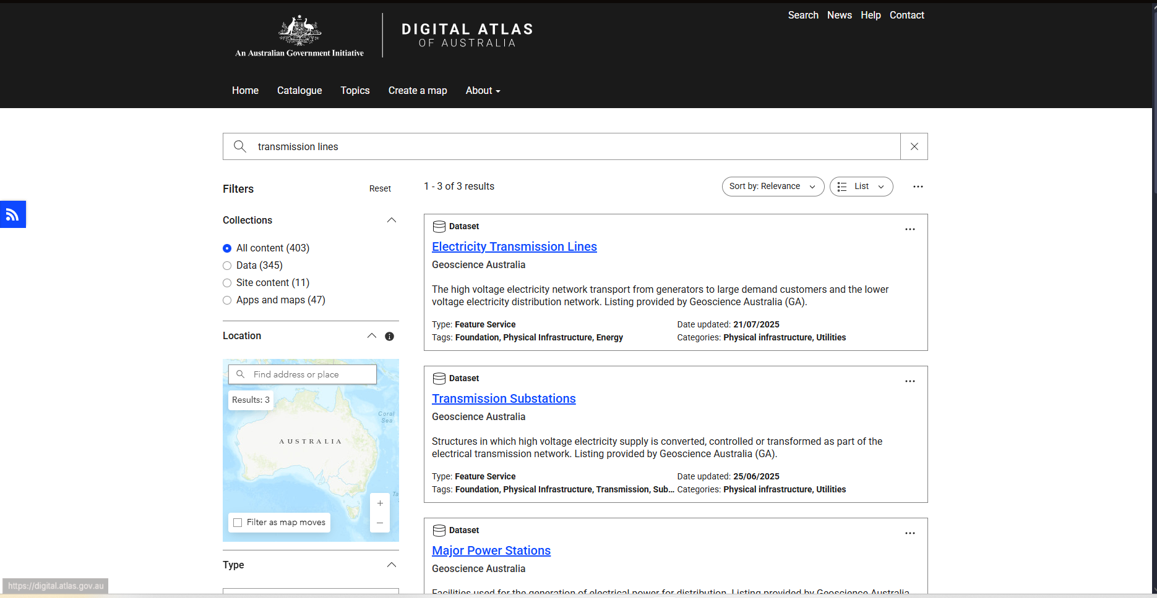
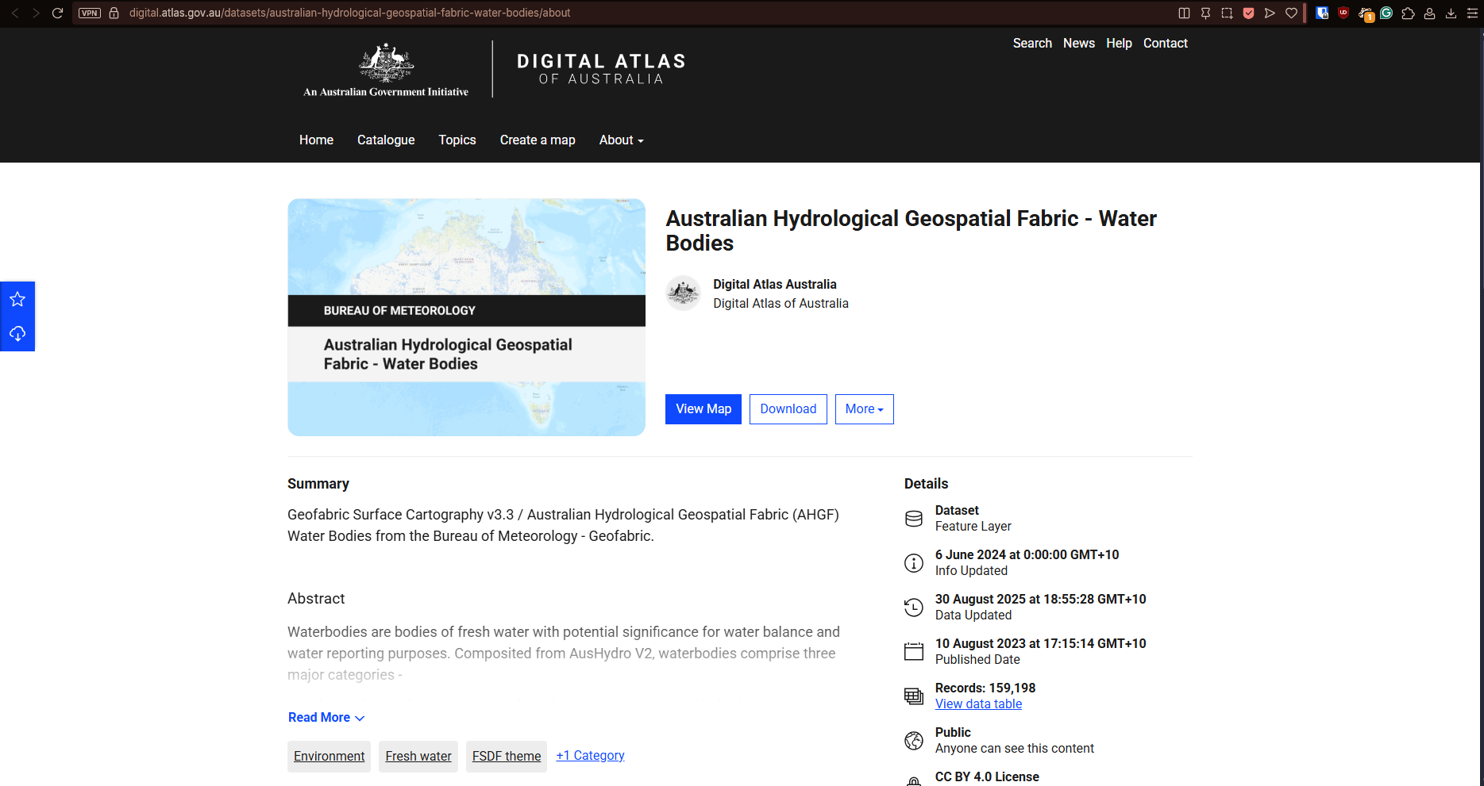
To much data in different places
Notes:
and to found that out you need to crawl through many different websites to find that data you need.

Slide 3
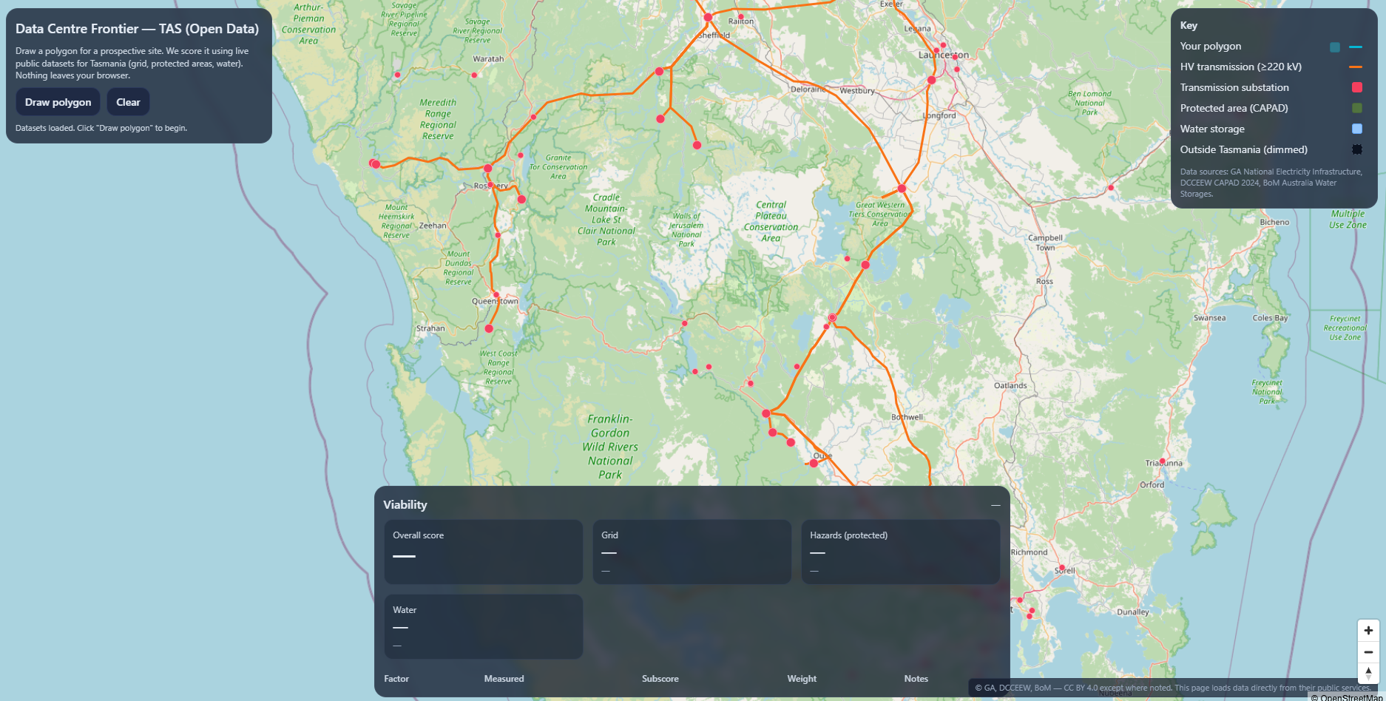

Data Centre Frontiers
Notes:
This is where Data Centre Frontier comes in. Data Centre Frontier grabs the open data from these websites and places them into a single map from there you can draw the footprint of the datacentre on the map and Data Centre Frontier will determine its score on how viable that location is.

Slide 4
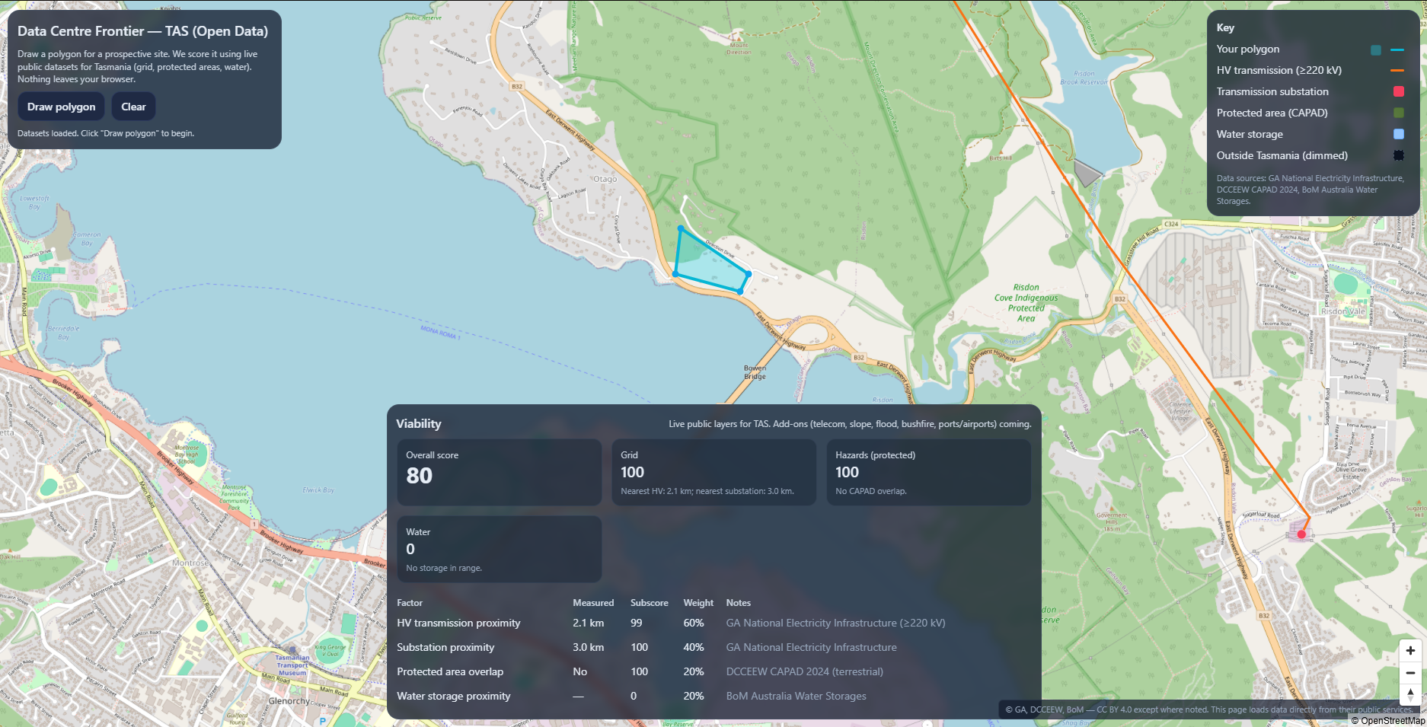
Notes:
It does this by checking the distance from the necessary infrastructure like; high voltage powerlines, water reservoir, population/workforce. It also checks climate, if the area you zoned falls into a protected area, flood zones and bush fire zones.
And in the future also be able to show you a prediction on how much it will cost to run that data centre, by gathering current cost per megawatt per hour and water usage/cost and display these as well so you are truly informed when deciding to build your next data.

Slide 5

Future and continuing development
Cost Per megawatt per hour
Cost of Water Per Liter Used
Additional Data points to get more accurate and complete results.

Slide 6

Data Transparency
Digital Frontiers is committed to fair and equitable use of open-source data.
Notes:
Data Centre Frontier will also include links as where its currently pulling data from so that may be independently audited by our users, government or organizations. We will always be transparent with what data we are using and where we are getting it from.
By gathering all this data and being transparent with it in one place Data Centre Frontier can act as your one stop go to when planning new data centre construction.

Slide 7
The Goto for Data Centre Planning

Slide 8
This slide is supposed to be empty for video editing.
Notes:
The Video playing now is a proof-of-concept version, developed by ChatGPT5.0 of what Data Centre Frontiers could look like and is missing most of the features described. But imagine what a dedicated analysis AI could do, if what we are describing was already made somewhat possible by an everyman AI software.

